Slide 1
Presentation will be hold directly to Power BI
Some screenshots included to have a first feeling how it looks like.
Some of its functions are:
Filters fully synced
Page Navigation through buttons
Triggering button for getting into ‘Coffee’ related business insights

Slide 2
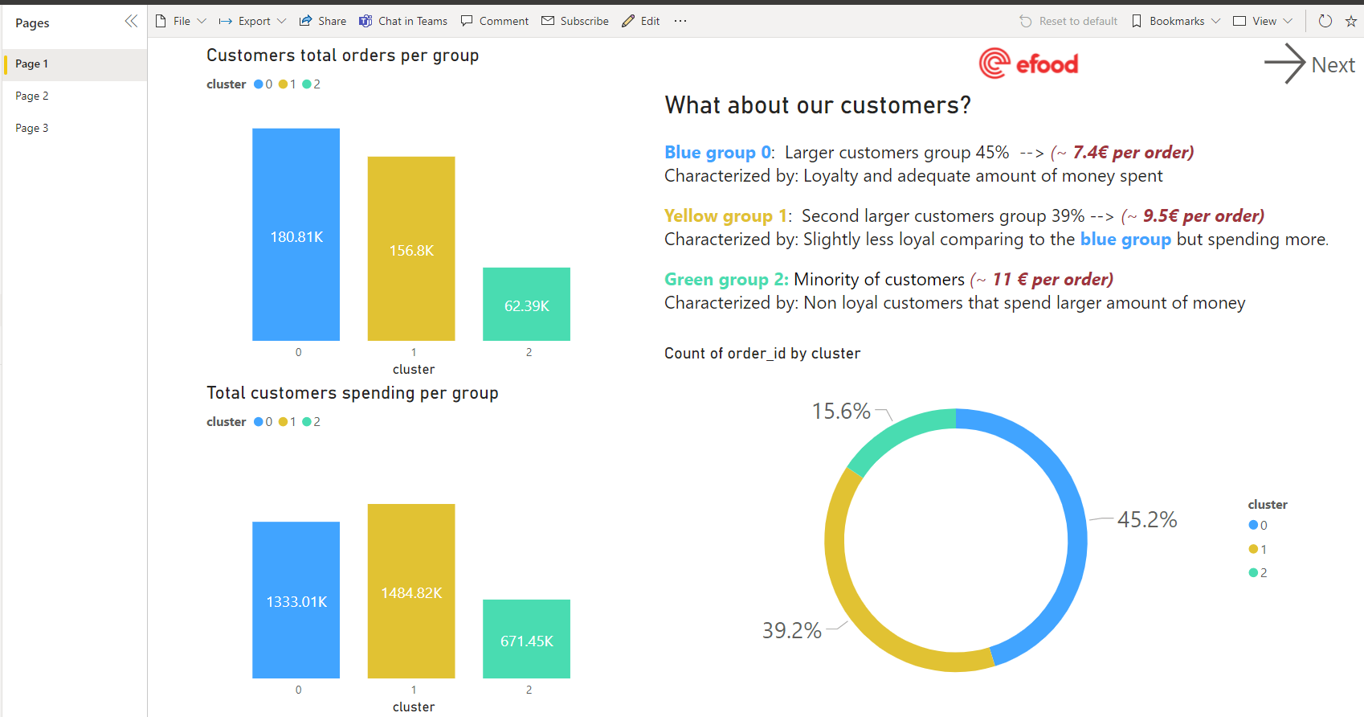

Slide 3
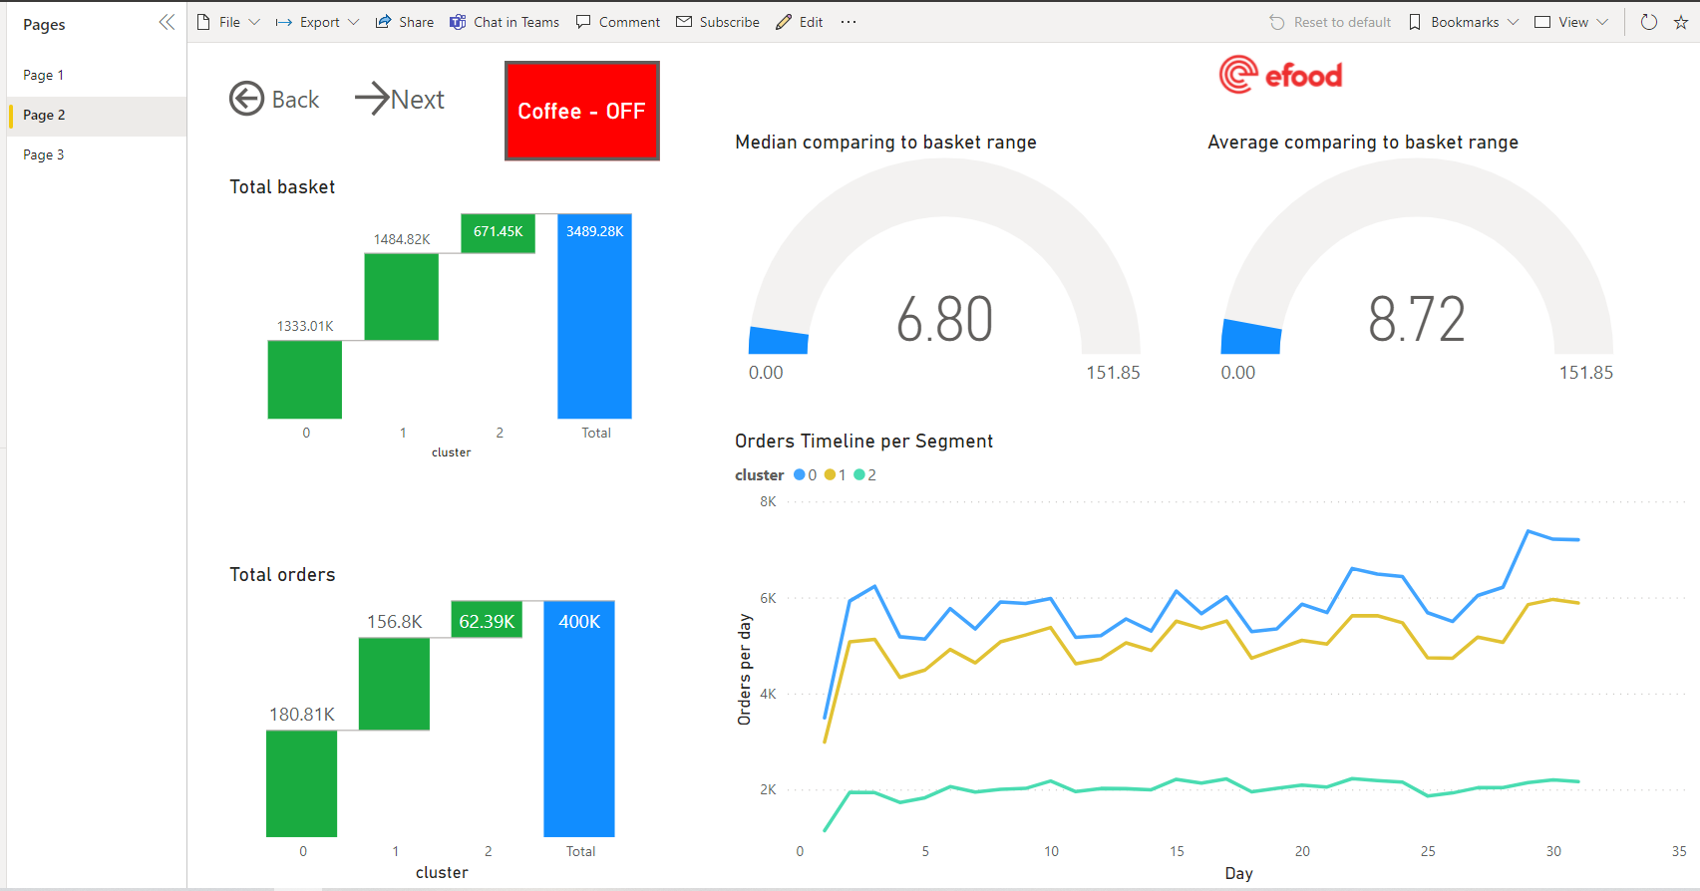

Slide 4
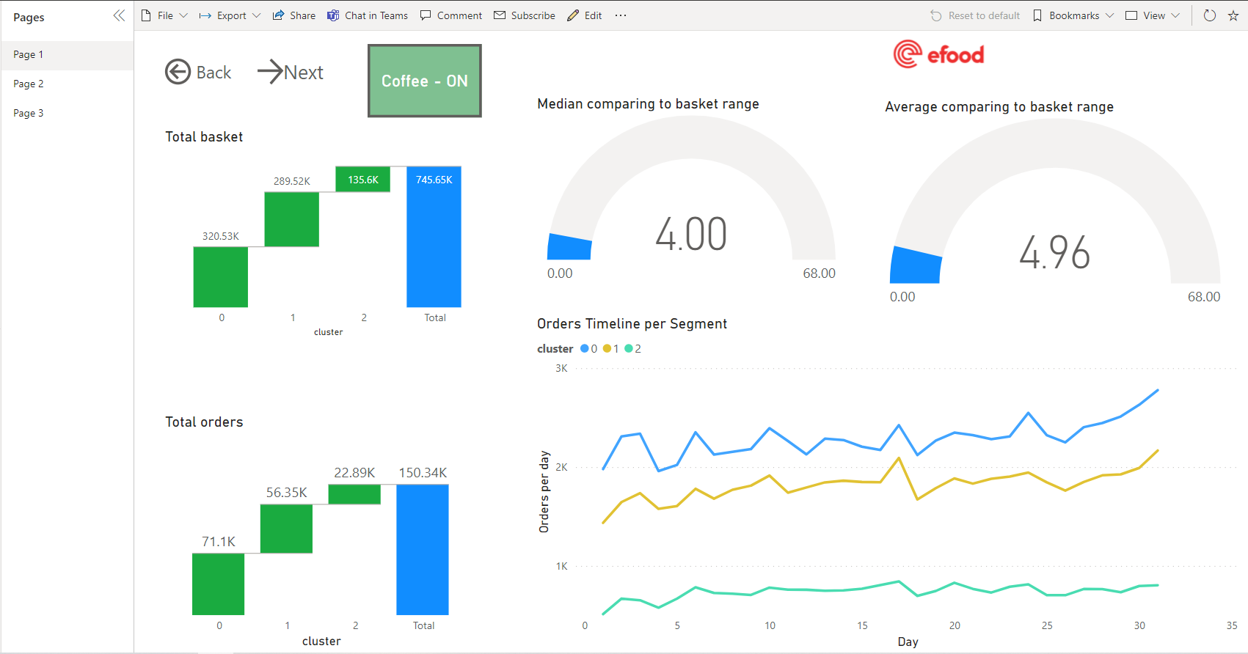

Slide 5
